Slide 1
UAV Design, Manufacture and Applications Arizona NASA Space Grant Undergraduate Research Internship Symposium
Pima Community College
4/12/14
Team Members
Nick Patzke
Gustavo Guerrero
Nick Morris

Slide 2
Overview
Motivation
The Quad
Design Process
Sample Test Data
Key Components
Sensors
Applications
Summary

Slide 3
Our Mission and Motivation
Apply physics and engineering concepts to optimize performance.
Design and Manufacture UAV capable of:
Spanning section of Grand Canyon
Capturing Still Photos and HD Video
Adding sensors or additional payload
Test the feasibility of UAV systems for:
Remote or inaccessible location monitoring
Topographical style mapping
Longer distance missions

Slide 4
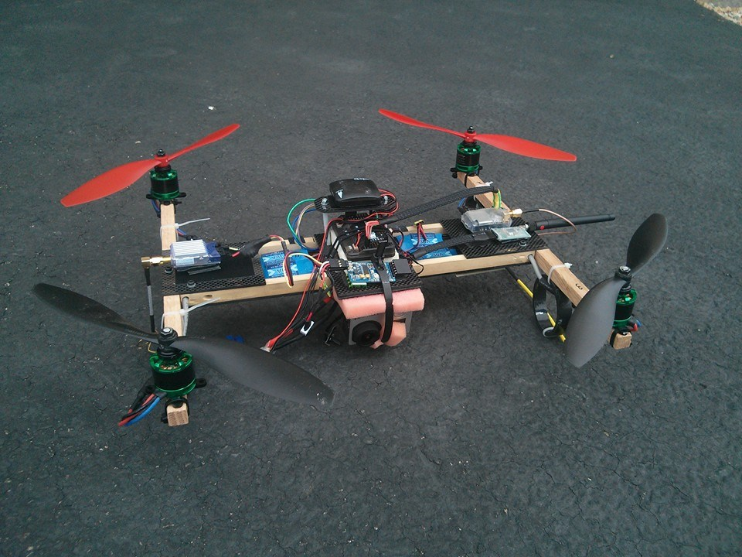
Proposed UAV: The Quad-Copter
What is a “Quad Copter”?
A multi-rotor, multi-engine helicopter
Why use a Quad?
Ability to hover and maintain position
Ability to carry various payloads
Limitations: flight time, limited payload weight, slower than fixed wing.
Buy (a kit) or build (from scratch)?
Pros and Cons for both:
Crash-durability, field reparability, cost, modification/addition of payloads.

Slide 5
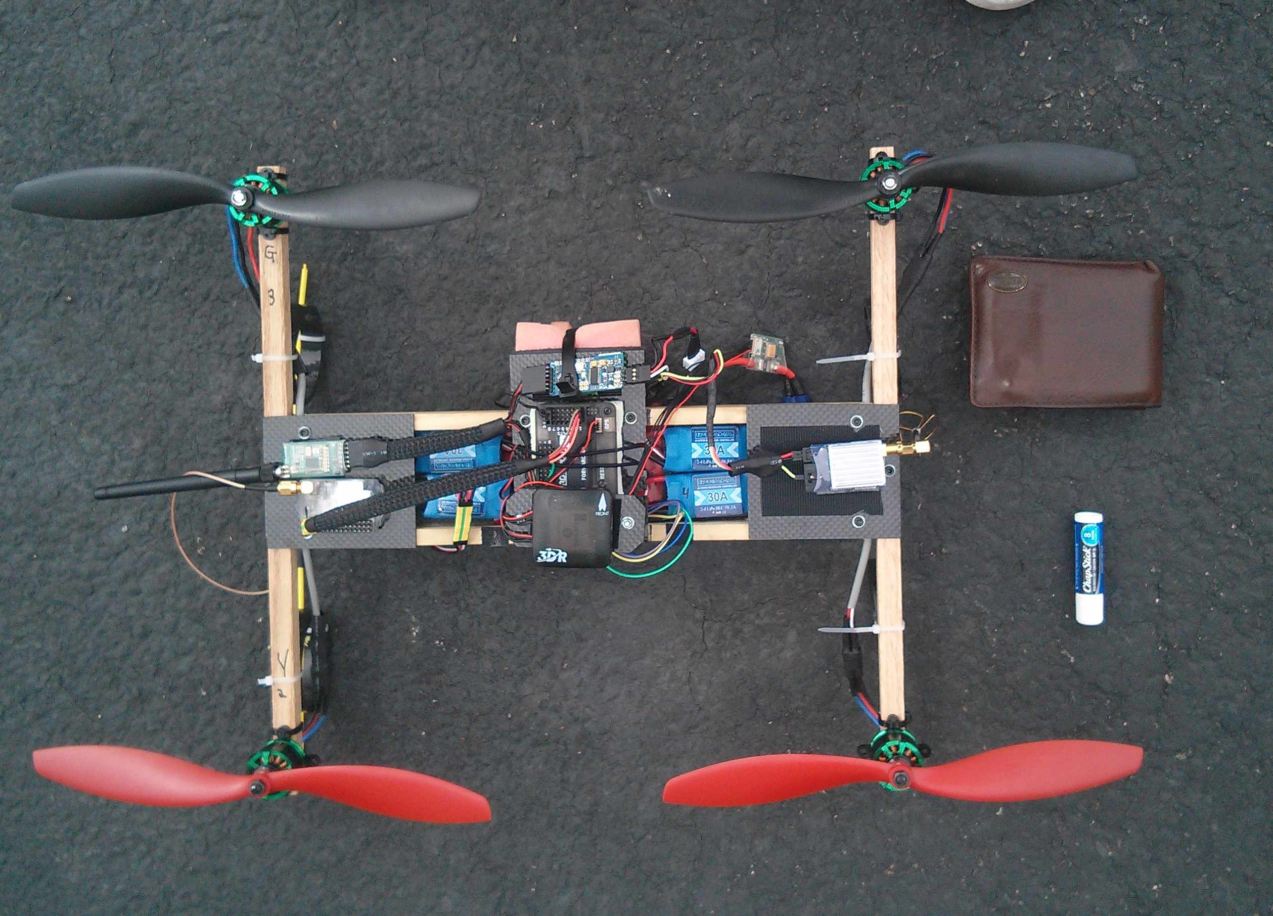
Design Process
First Build
We need a Quad Copter
Research
Flight controller, motor and propeller (drive), radio communication, batteries, construction techniques, hardware
Brainstorm
Frame geometry, component selection & layout
Implementation
H-frame components and layout
Build a prototype
Test and Redesign
Testing- Large current draw limited flight time
Redesign- Reduce current draw. Further research drive efficiency

Slide 6
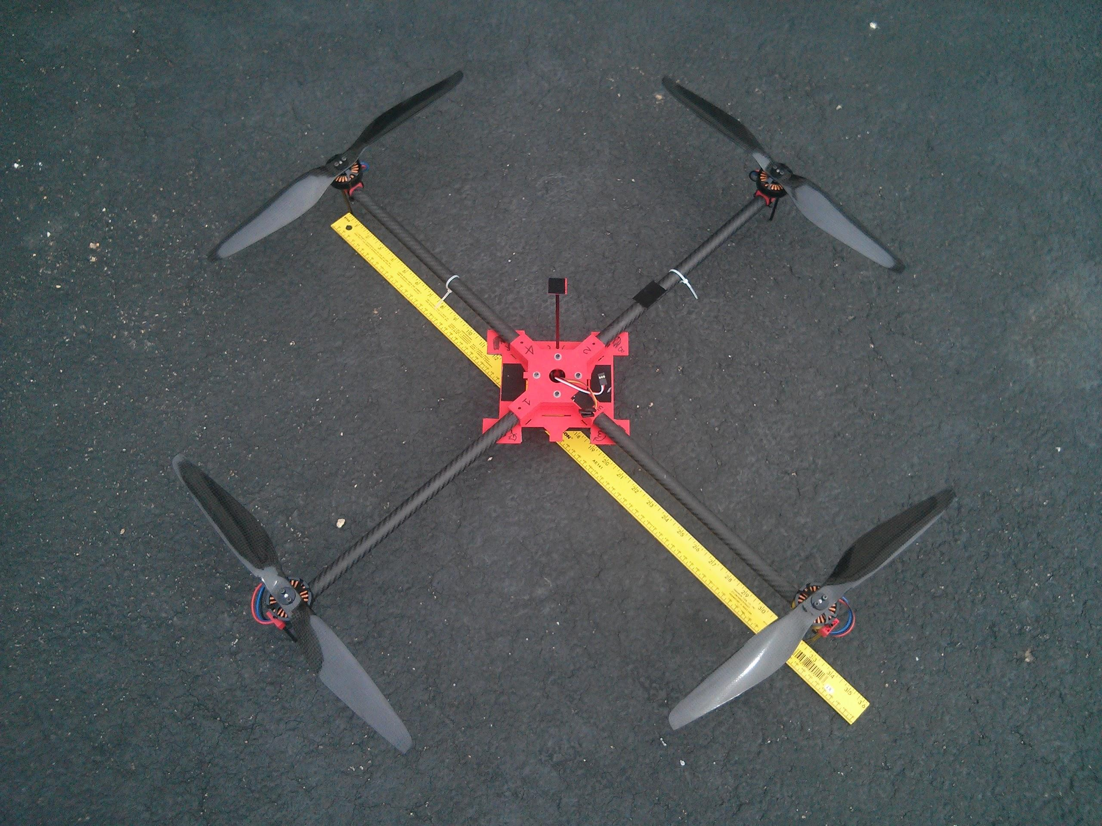
Re-Design Process
Frame and Drive Redesign
Redesign original copter to use less current
Research
Optimum drive combination, differences in battery chemistry and voltage
Brainstorm
How to test motor, propellers and batteries
Decrease weight
Implementation
Testing motor, propeller and battery combinations on fabricated “test rig”
Optimize frame geometry and weight
Build a Prototype
Test and Redesign
Testing- Roughly twice as efficient (new drive lifts twice as much weight with same electrical input)
Redesign- Further research drive efficiency

Slide 7
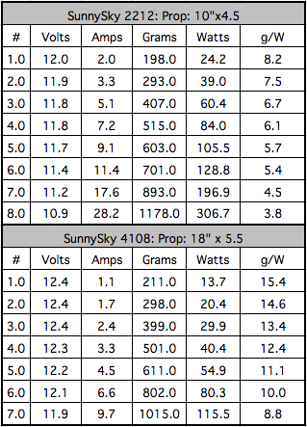
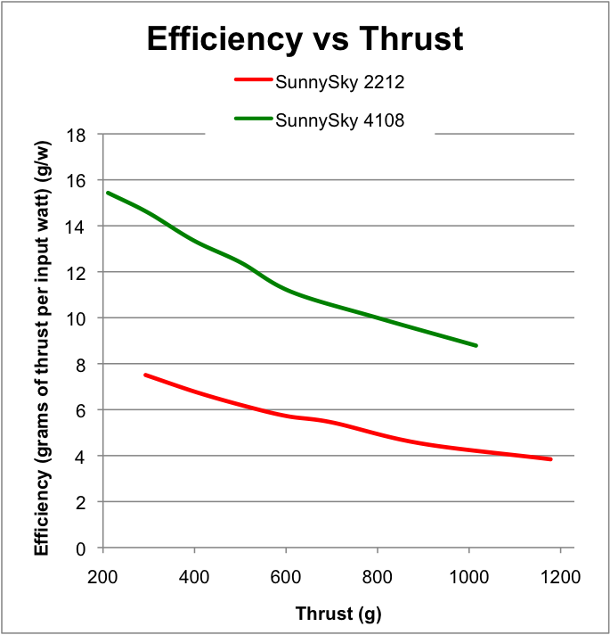
Sample Motor Efficiency Test Data
Testing:
3 motors
5 propeller sizes
2 battery voltages
Total of 30 Combinations

Slide 8
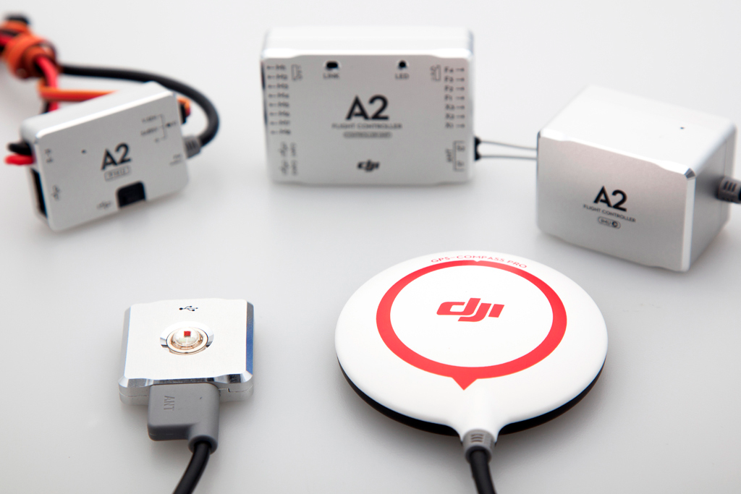
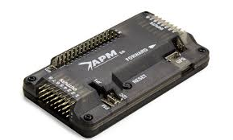
Flight Controller (The Brain)
Key sensors used in flight control:
GPS
Barometer
Accelerometer and Gyroscopes
Battery Voltage and Current
Using sensors, the flight controller stabilizes the vehicle and adjusts accordingly to the pilot’s commands.
Which controller is better?
DJI NAZA A2
APM 2.6
Notes:
Sensors – but there are more
Talk about the flight controller more and what it does. Why did we pick it, why is it important?
(gps, waypoints, autonomous flight, etc)
Depending on what you plan on doing with UAV, every flight controller has it’s application

Slide 9
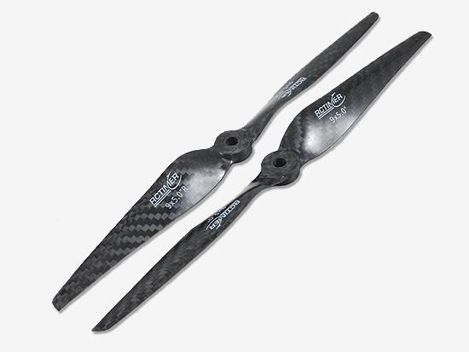
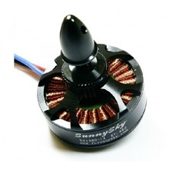
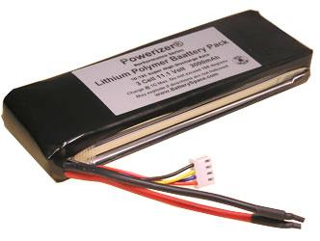
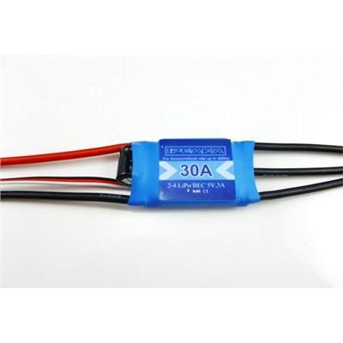
Drive
Motor: 120g
SunnySky 4108 390kv
Propeller: 25g CF 18” CW/CWW
ESC: 25g iPeaka, Quattro, Afro
Lithium Ion Polymer Battery
3s 11.1Vnom 6.4Ah 400g
Notes:
http://i01.i.aliimg.com/wsphoto/v1/1418977921_1/Sunnysky-X4108S-font-b-KV-b-font-380-480-600-multi-rotor-copter-font-b-brushless.jpg_220x220.jpg

Slide 10
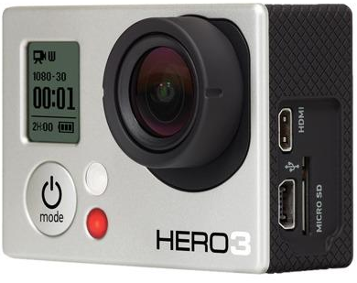
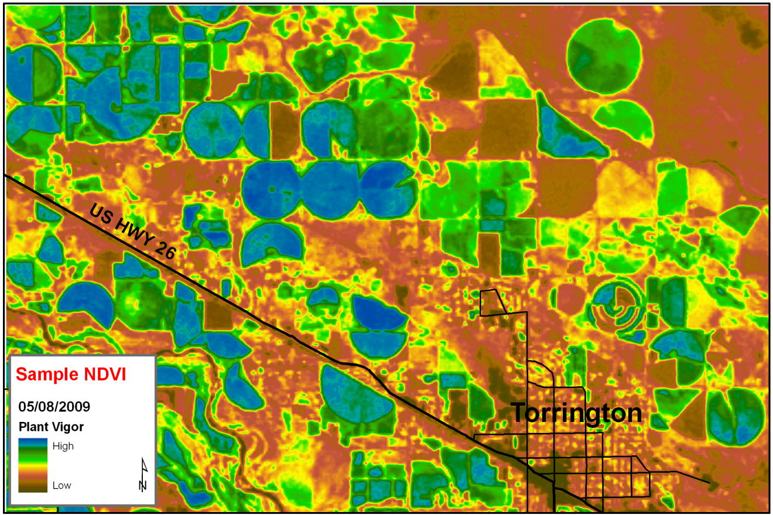
Sensors and Applications
Camera Imagery
Photography/Film
3D and thermal mapping
Thermal Imaging
NDVI
RF receivers (wildlife tracking)
Agricultural
Geiger counter
Search and Rescue
HAZMAT/Disaster Scout
And so much more…

Slide 11
Summary
YOUTUBE CHANNEL
Motivation
The Quad
Design Process
Sample Test Data
Key Components
Sensors
Applications

Slide 12
Acknowledgements
Pima Community College
Prof. Michael Sampogna
Dr. Denise Meeks
Jack Crabtree, ANSR
Susan Brew, UA
Arizona NASA Space Grant

